Slide 1
Naruto Boruto Noruto Baruto
Presenter: 徐福臨(0416074)
Reference:
Kaiming He, Xiangyu Zhang, Shaoqing Ren, Jian Sun. Deep Residual Learning for Image Recognition. arXiv:1512.03385, 2015.

Slide 2

Outline
Introduction
Data Acquisition & Preprocessing
Method
- ResNet
- Uniform CNN
- ResNet + DT
- ResNet + SVM
Performance

Slide 3
Outline
Introduction
Data Acquisition & Preprocessing
Method
- ResNet
- Uniform CNN
- ResNet + DT
- ResNet + SVM
Performance

Slide 4

Introduction
Task: To separate comic graphs between Naruto and Boruto
Key words: Feature extracting, Classification, Model design, Optimization
Author: Kishimoto Masashi
Author: Ikemoto Mikio
Assistant of Masashi for 15 years

Slide 5

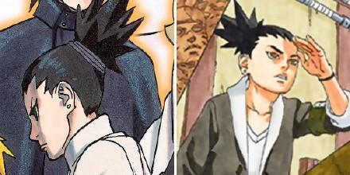
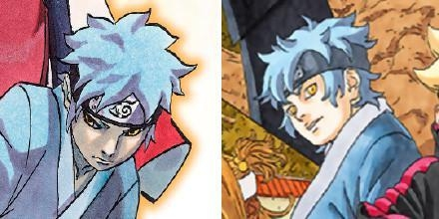
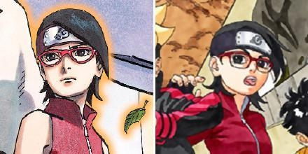
Introduction
Some examples

Slide 6
Outline
Introduction
Data Acquisition & Preprocessing
Method
- ResNet
- Uniform CNN
- ResNet + DT
- ResNet + SVM
Performance

Slide 7
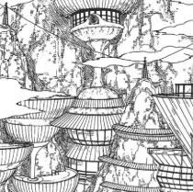
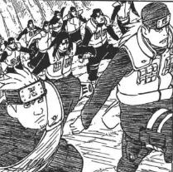
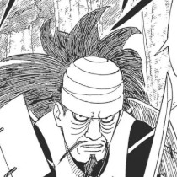
Data Acquisition
Take screenshot from the online comic website
The data collected should
have clear outline (most of them include characters)
not be landscape picture
not include dialogue
not center on specific characters
I expect the model can focus on the “style” (features) to do classification

Slide 8
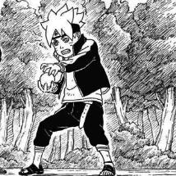
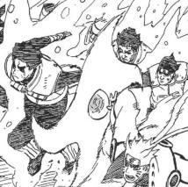
Data Preprocessing
For training data
There are 590 data for training (about 50%-50%)
Divide the RGB value by 255 to make the initialization of the model easier
The size of screenshot is (210, 210), I rescale it to (192, 192) by interpolation
Every data is flipped horizontally and add to the training set (1180 in total)
(210, 210)
(192, 192)
Horizontal Flipping

Slide 9
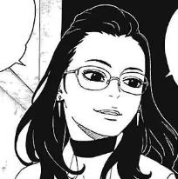
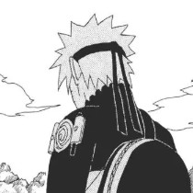
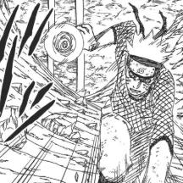
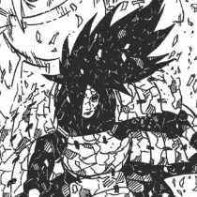
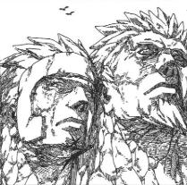
Data Preprocessing
For testing data
There are 50 data for testing (50%-50%)
The preprocessing method is the same as training data except flipping
The rules for choosing testing data
Characters rarely appearing in training set
Different angle of the character
Different costume of the character
Noisy effects added to the picture

Slide 10
Outline
Introduction
Data Acquisition & Preprocessing
Method
- ResNet
- Uniform CNN
- ResNet + DT
- ResNet + SVM
Performance

Slide 11
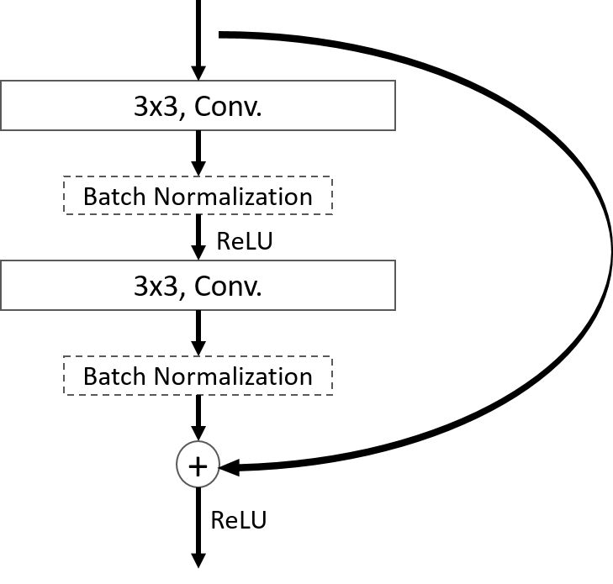
Method (ResNet)
X
Deeper is better
Problem: Gradient Vanishing, Identical mapping
Solution:
Original
Input: X
Output: H(X)
ResNet
Input: X
Output: Res(X) + X
What we want to learn is the residual Res(X) = H(X) - X
X
Basic Block
Res(X) + X

Slide 12
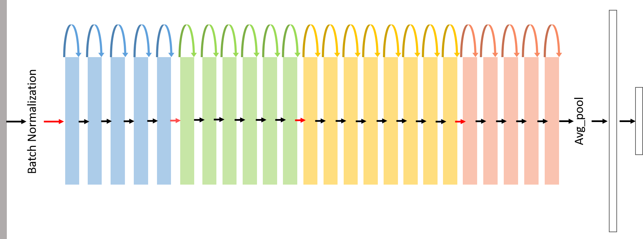
Method (ResNet)
Red Arrow: stride = 2, the size of data/2
fc (32, 2)
5 blocks
3x3 Conv. 16
6 blocks
3x3 Conv. 32
8 blocks
3x3 Conv. 64
5 blocks
3x3 Conv. 128
fc (1152, 32)
7x7 Conv. 16
Size: 96
Size: 48
Size: 24
Size: 12
Size: 192

Slide 13
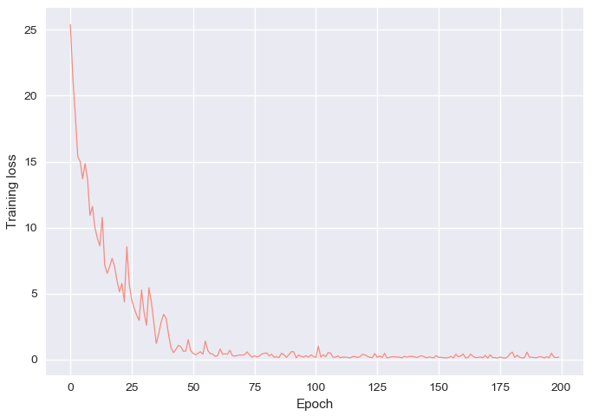
Method (ResNet)
Training Loss:
[Hyper Parameters]
Batch size: 32
Learning rate: 0.01
divide by 10 at epoch 40
divide by 100 at epoch 70
Total Epoch: 200
[Optimization]
Optimizer: SGD, momentum=0.9
Loss Function: Cross Entropy
Network Initialization: He initialization
[Accuracy]
Testing set: 92%
Training set: 99.03%

Slide 14
Outline
Introduction
Data Acquisition & Preprocessing
Method
- ResNet
- Uniform CNN
- ResNet + DT
- ResNet + SVM
Performance

Slide 15
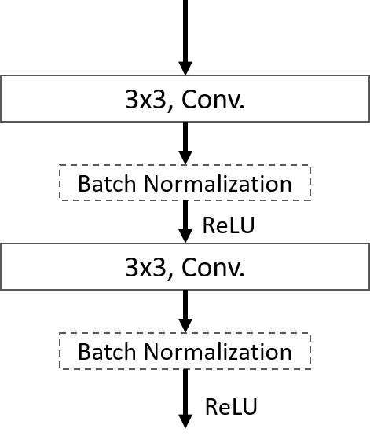
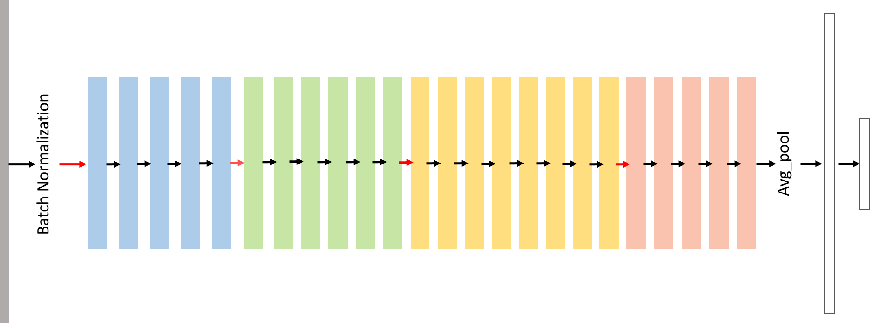
Method (Uniform CNN)
Experimental implement
Remove the shortcut of ResNet
Every Block = Input: X
Output: H(X)
fc (32, 2)
5 blocks
3x3 Conv. 16
6 blocks
3x3 Conv. 32
8 blocks
3x3 Conv. 64
5 blocks
3x3 Conv. 128
fc (1152, 32)
7x7 Conv. 16
Size: 96
Size: 48
Size: 24
Size: 12
Size: 192

Slide 16
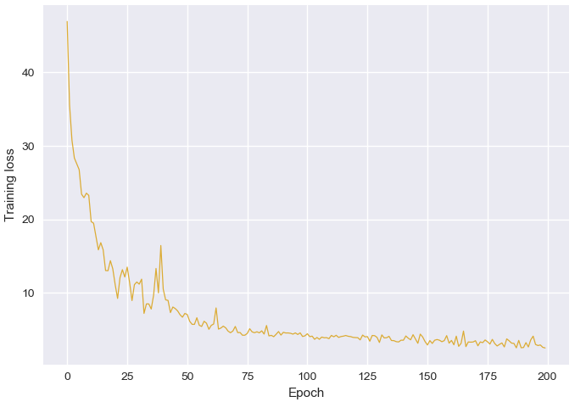
Method (Uniform CNN)
Training Loss:
[Hyper Parameters]
Batch size: 32
Learning rate: 0.01
divide by 10 at epoch 40
divide by 100 at epoch 70
Total Epoch: 200
[Optimization]
Optimizer: SGD, momentum=0.9
Loss Function: Cross Entropy
Network Initialization: He initialization
[Accuracy]
Testing set: 78%
Training set: 96.53%

Slide 17
Outline
Introduction
Data Acquisition & Preprocessing
Method
- ResNet
- Uniform CNN
- ResNet + DT
- ResNet + SVM
Performance

Slide 18

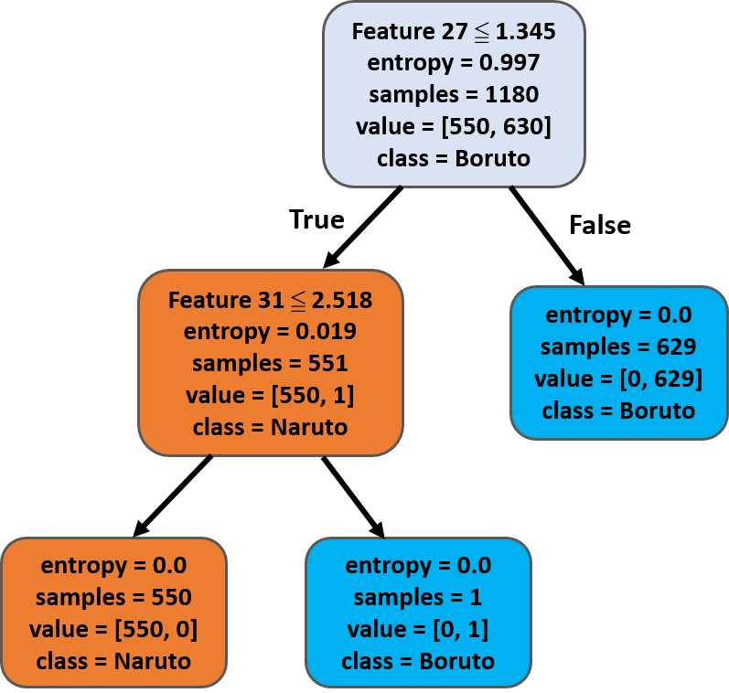
Method (Decision Tree)
Encoded Feature
Use ResNet model as encoder
Encode the data to 32 summarized features
(Remove the last fully connected layer)
Compute the purity by entropy
[Accuracy]
Testing set: 94%
Training set: 100%

Slide 19
Outline
Introduction
Data Acquisition & Preprocessing
Method
- ResNet
- Uniform CNN
- ResNet + DT
- ResNet + SVM
Performance

Slide 20
Method (SVM)
Use ResNet model as Encoder
Kernel: Radial Basis Function Kernel (RBF), gamma = 1/3
[Accuracy]
Testing set: 92%
Training set: 100%
Kernel: Sigmoid Kernel
[Accuracy]
Testing set: 90%
Training set: 99.15%
b
X₀
X₁
X₂
X₃
.
.
.
X_{n}
RBF
Similarity
Vote
RBF
Output
F = Output[ Σ_{m} β_{m}RBF(X,μ_{m}) ]+b
RBF: Similarity
β : Vote (sign)
RBF
RBF Network

Slide 21
Outline
Introduction
Data Acquisition & Preprocessing
Method
- ResNet
- Uniform CNN
- ResNet + DT
- ResNet + SVM
Performance

Slide 22
Performance
 | Accuracy (Testing)
ResNet | 92%
Uniform CNN | 78%
ResNet + Decision Tree | 94%
ResNet + SVM (RBF) | 92%
Conclusion
ResNet is quite good at extracting features
Uniform CNN fails in deep network architecture
Decision Tree outperforms others in classification
SVM is similar to fully connected layer architecture

